Slide 1
Citi Bike Demand and Allocation Prediction
Mingran Cao

Slide 2
The problem
1. How many bikes are needed in total ? (Demand Prediction)
Key factors: season, weekday and hour
2. How are bikes distributed across stations?
Key factors: geographical location, hour and pagerank of the station
3. How can bike allocation be optimised

Slide 3
How many bikes are needed in total?

Slide 4
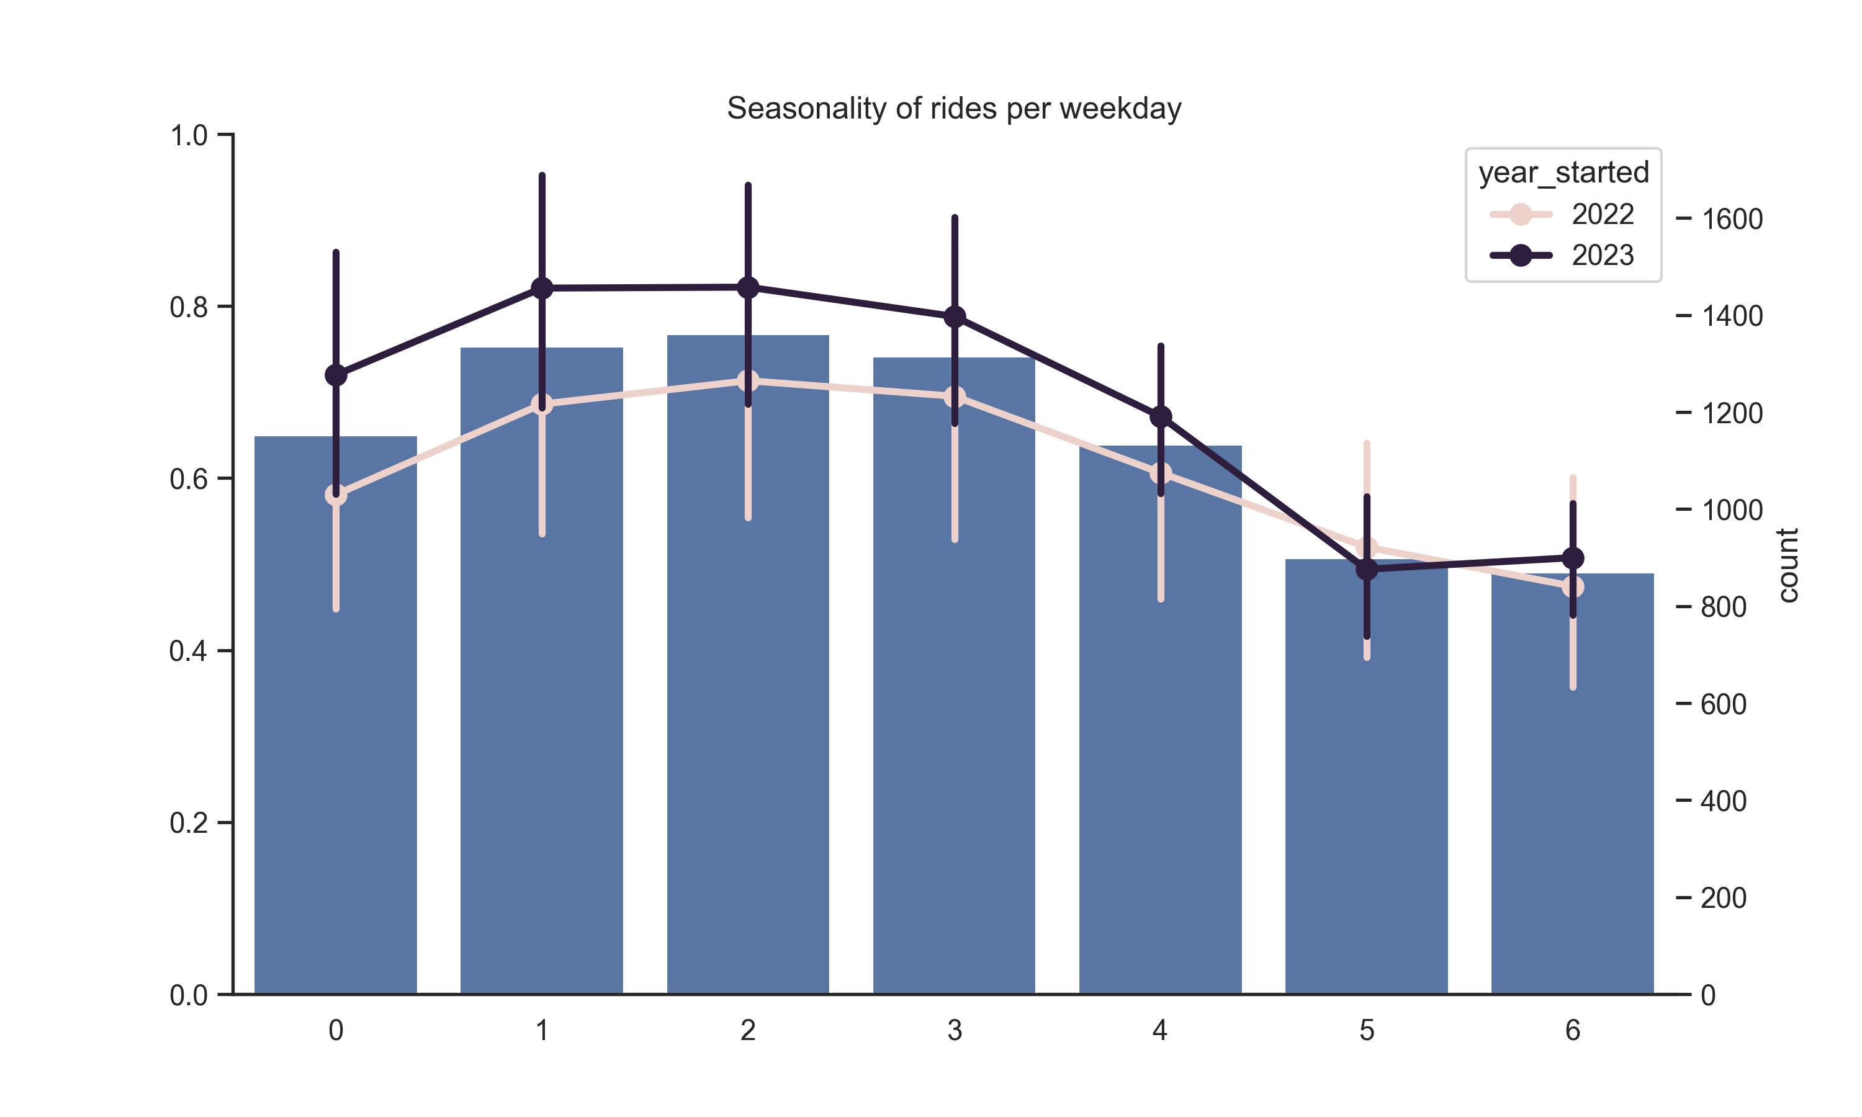
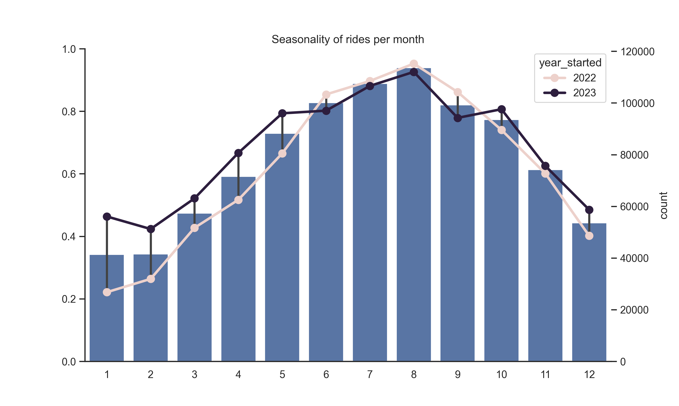
Factors that influence number of rides
Month
Weekday – peak number of ride
Month number
Weekday number

Slide 5
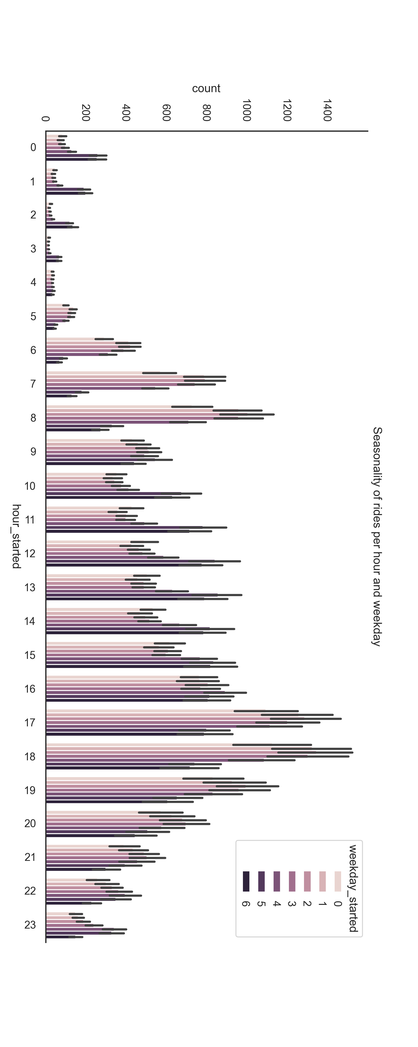
Weekday and weekend have different hourly ride distribution
Weekday peaks
Weekday peaks
Weekend Peaks
Number of bike rides
Hour

Slide 6
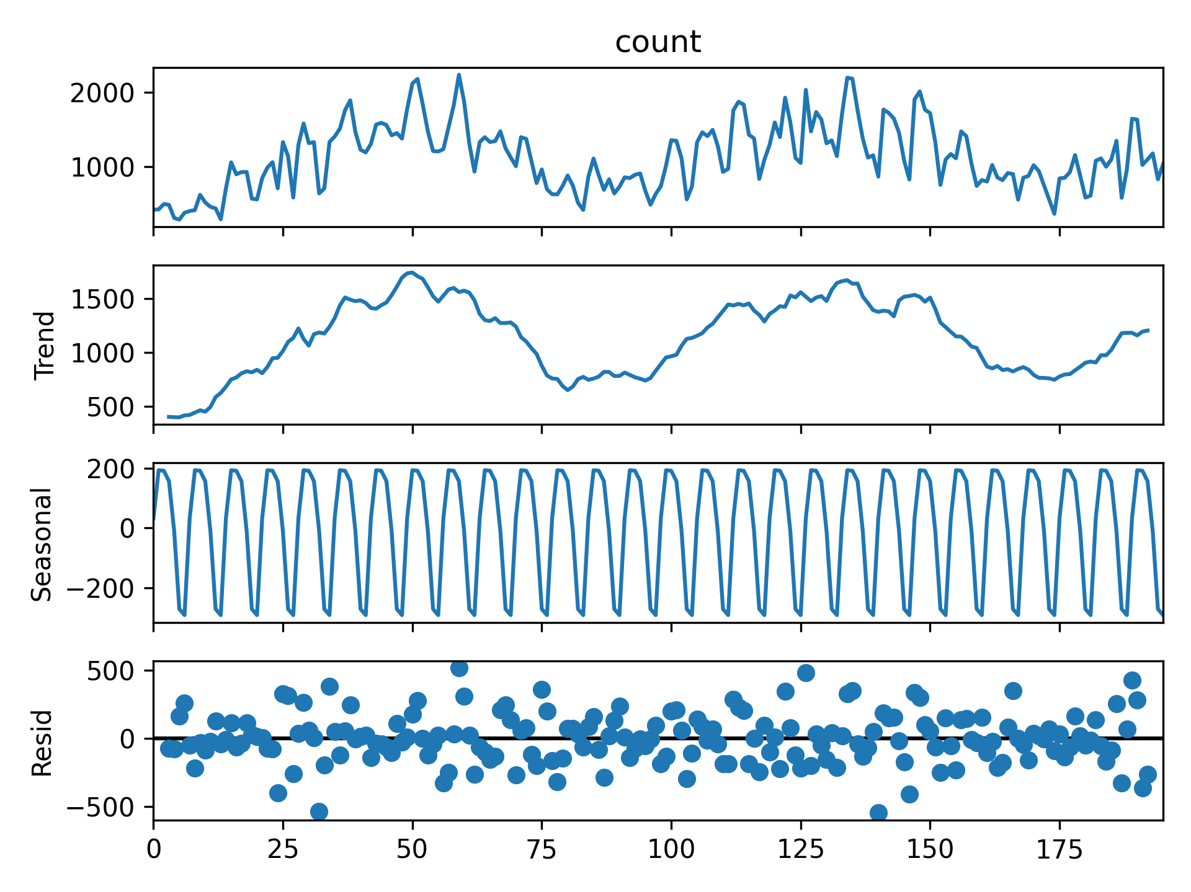
To predict the bike demand per day
Use timeseries forecasting model
Use gradient boosted tree algorithms
Features: year, month, weekdays,
To predict: peak bike demand of the day
SARIMA is not enough → TBATS

Slide 7
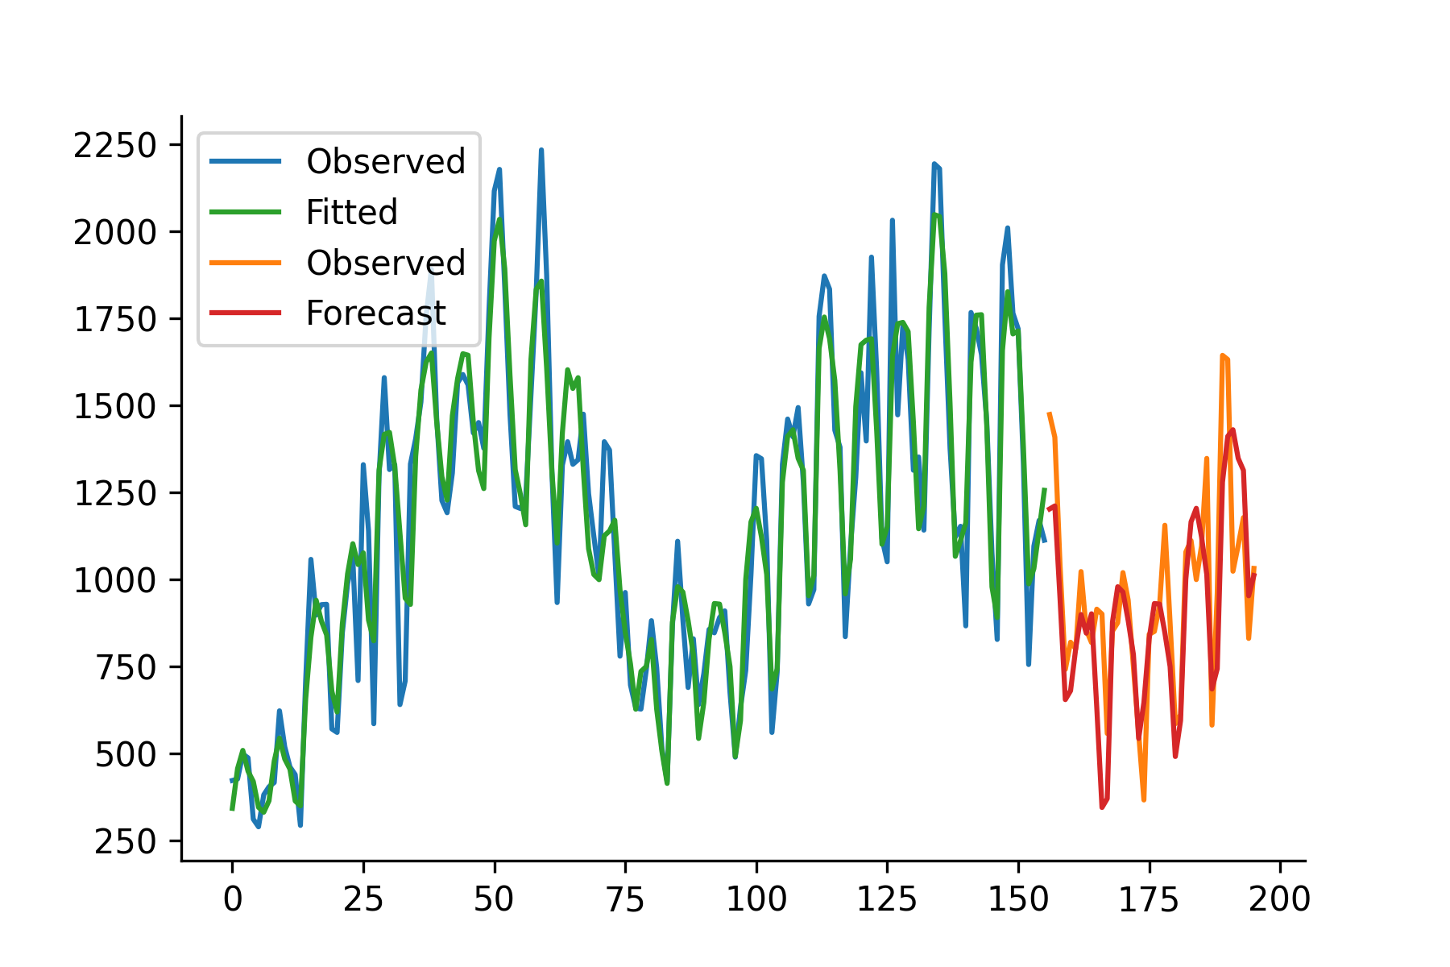
Model Comparison
Demand forecast from the best model
Model | MAE | RMSE | MAPE
TBATS | 235.36766158998800 | 271.405888197068 | 24.49188368426250
XGBoost | 144.62927017211900 | 192.48900666735000 | 15.711701201501700
XGBoost with time-lagged features | 141.8521827697750 | 190.42098087428500 | 15.990484020526500
Bike Count
Both XGBoost model have hyperparameters optimized through grid search
Number of timepoints

Slide 8
Conclusion
Overall bike demand doesn’t increase every year.
Daily bike demand fluctuate based on season and weekday and hour.
Daily bike demand can be predicted and accurately forecasted.
Peak bike storage for 2024/11/04: 1255.3267 bikes.

Slide 9
How are bikes distributed across stations

Slide 10
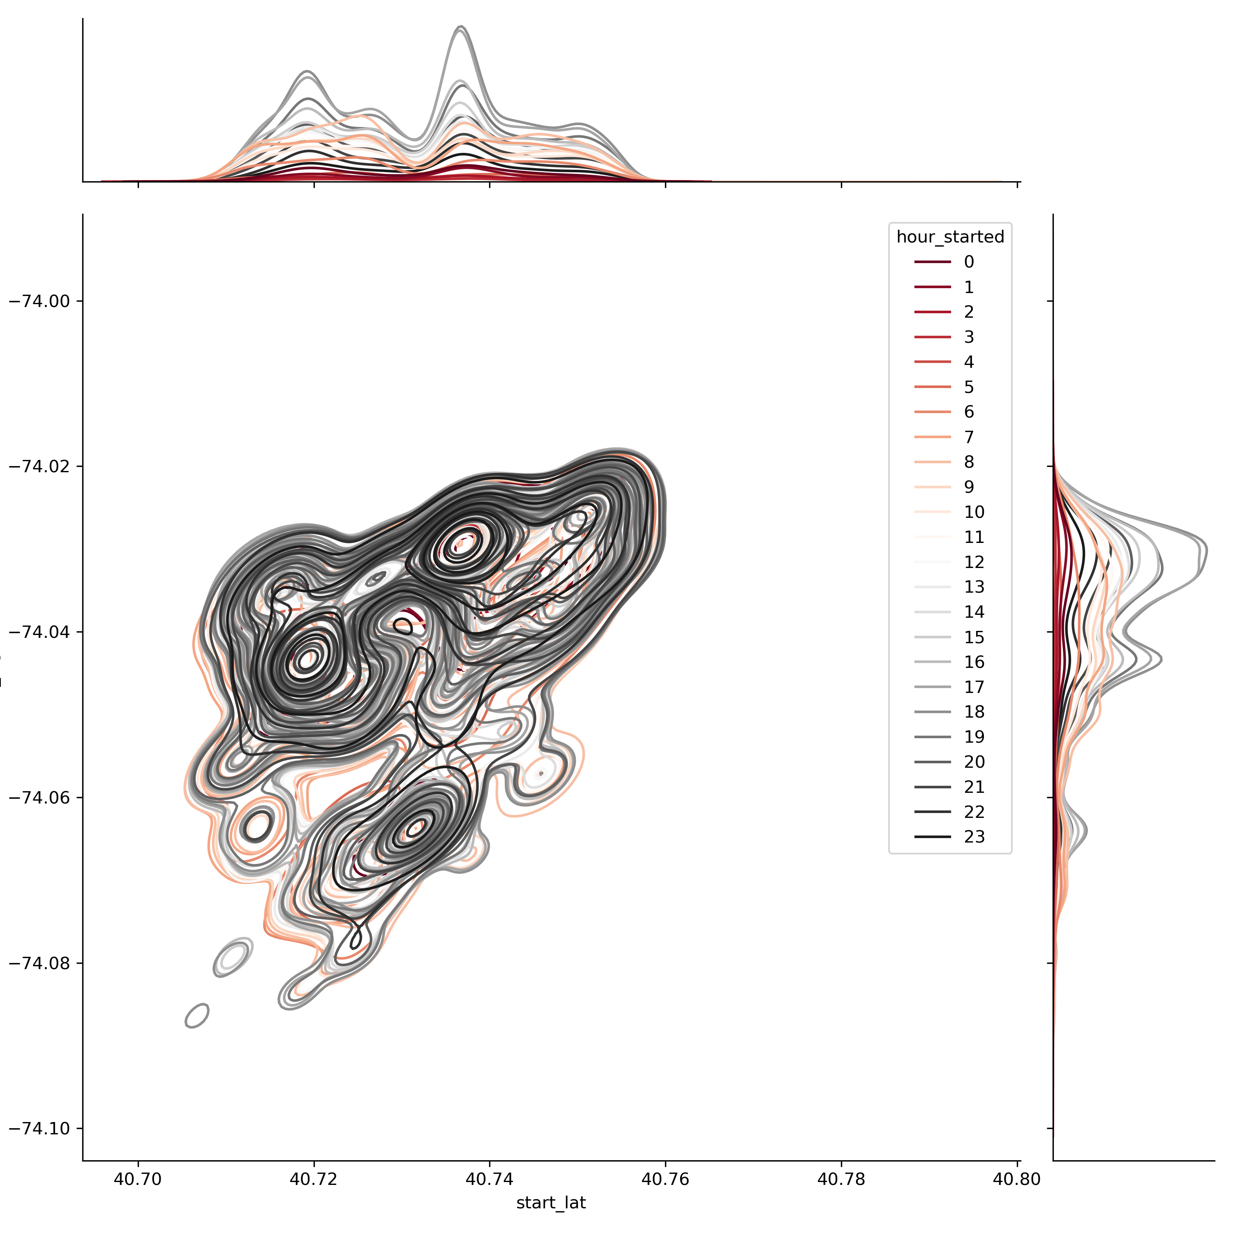
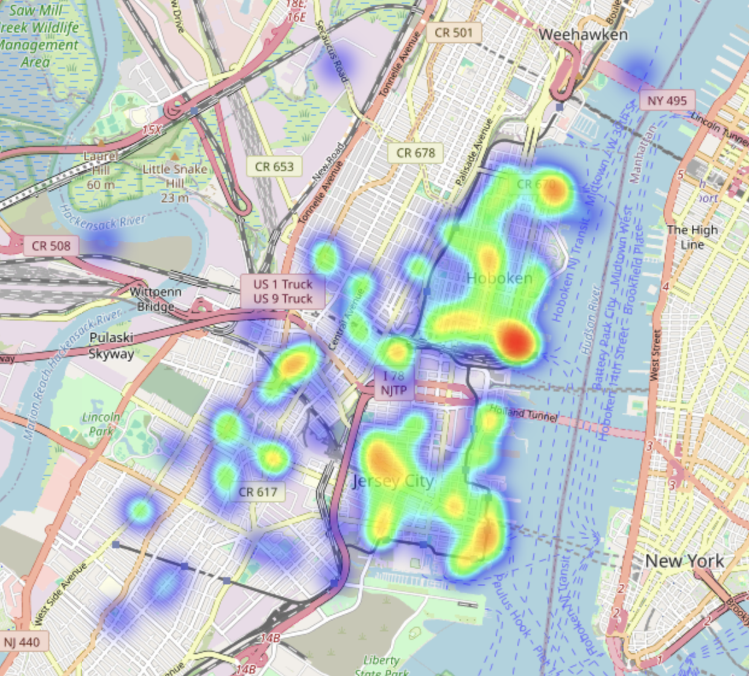
Geo-spatial Exploration
Hour
Location
latitude
longitude

Slide 11
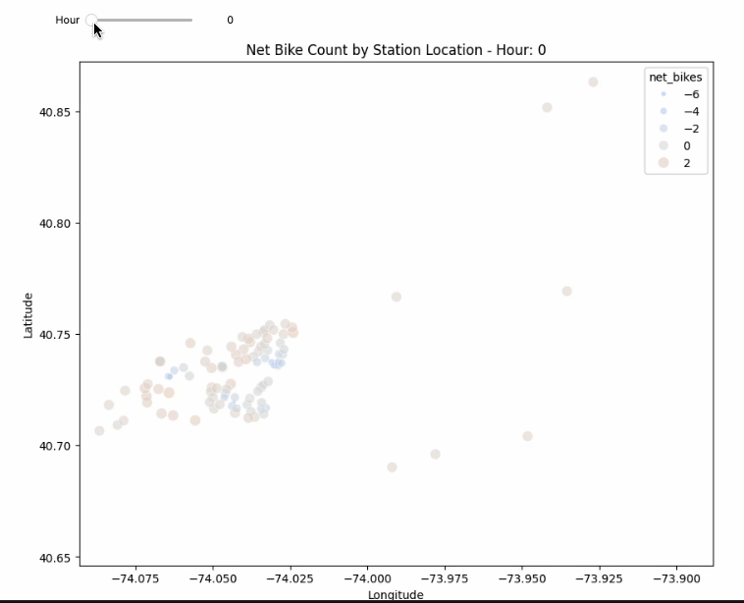
Geo-spatial Exploration – bike ride directionality
Morning and evening peak time despite having similar geo-spatial pattern, have different directionality in terms of how bike ride journeys
→ Indicating that probably page rank will be a good feature

Slide 12
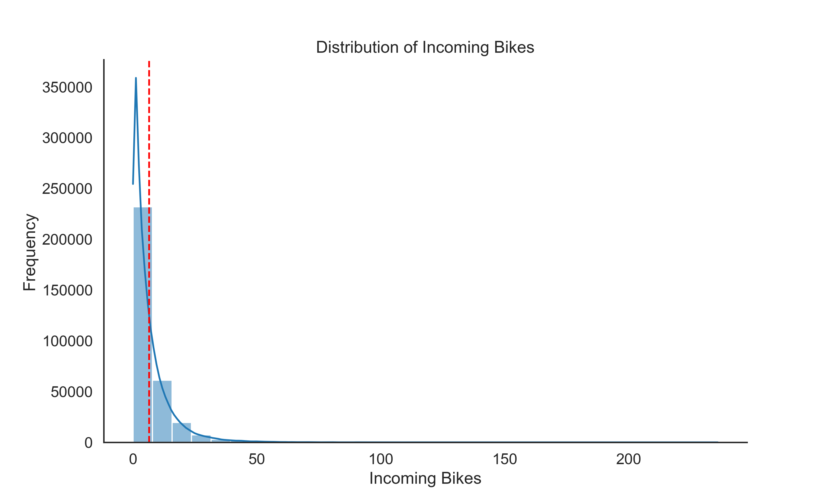
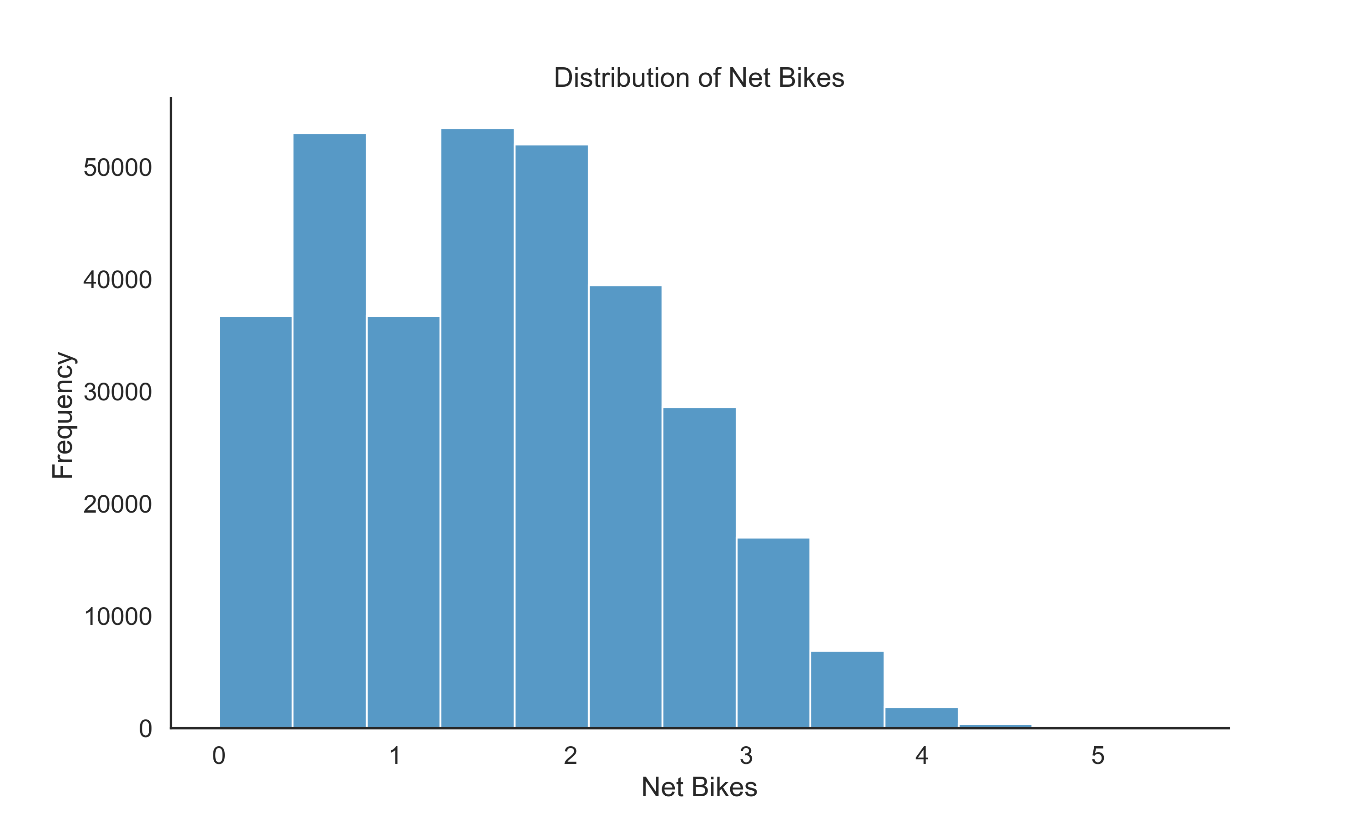
Model training and comparison
Features:
1. location (longitude, latitude)
2. Temporal features (weekday, hour)
3. Graph feature (betweenness, community, pagerank)
To predict hourly incoming bikes and outgoing bikes (2024 data as test data)
Model | MAE | RMSE | MAPE
XGBoost | 4.953383 | 7.688102 | 335.977646
Log-transformed
Model | MAE | RMSE | MAPE
XGBoost (log-transformed) | 0.490854 | 0.637414 | 49.620517
XGBoost (log-transformed + fitler) | 0.281201 | 0.366371 | 9.442455
Use medium of net bike + a small bike storage buffer as bike supply to stations being filtered

Slide 13
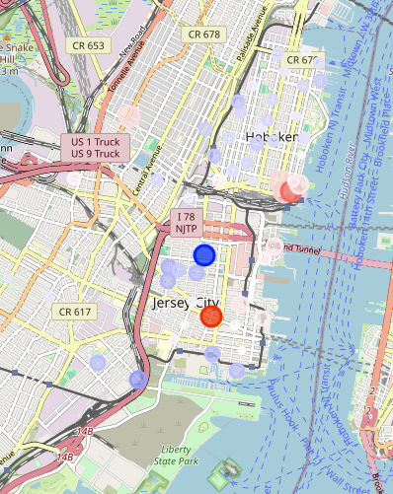
Model training and comparison
Features:
1. location (longitude, latitude)
2. Temporal features (weekday, hour)
3. Graph feature (betweenness, community, pagerank)
To predict hourly incoming bikes and outgoing bikes (2024 data as test data)
Predictions 2024 November 4th 8am
Model | MAE | RMSE | MAPE
XGBoost (log-transformed) | 0.490854 | 0.637414 | 49.620517
XGBoost (log-transformed + fitler) | 0.281201 | 0.366371 | 9.442455
XGBoost + lagged graph features | 0.275969 | 0.361943 | 9.332539
XGBoost (log-transformed + fitler) parameter optimised | 0.182729 | 0.2298 | 6.371522

Slide 14
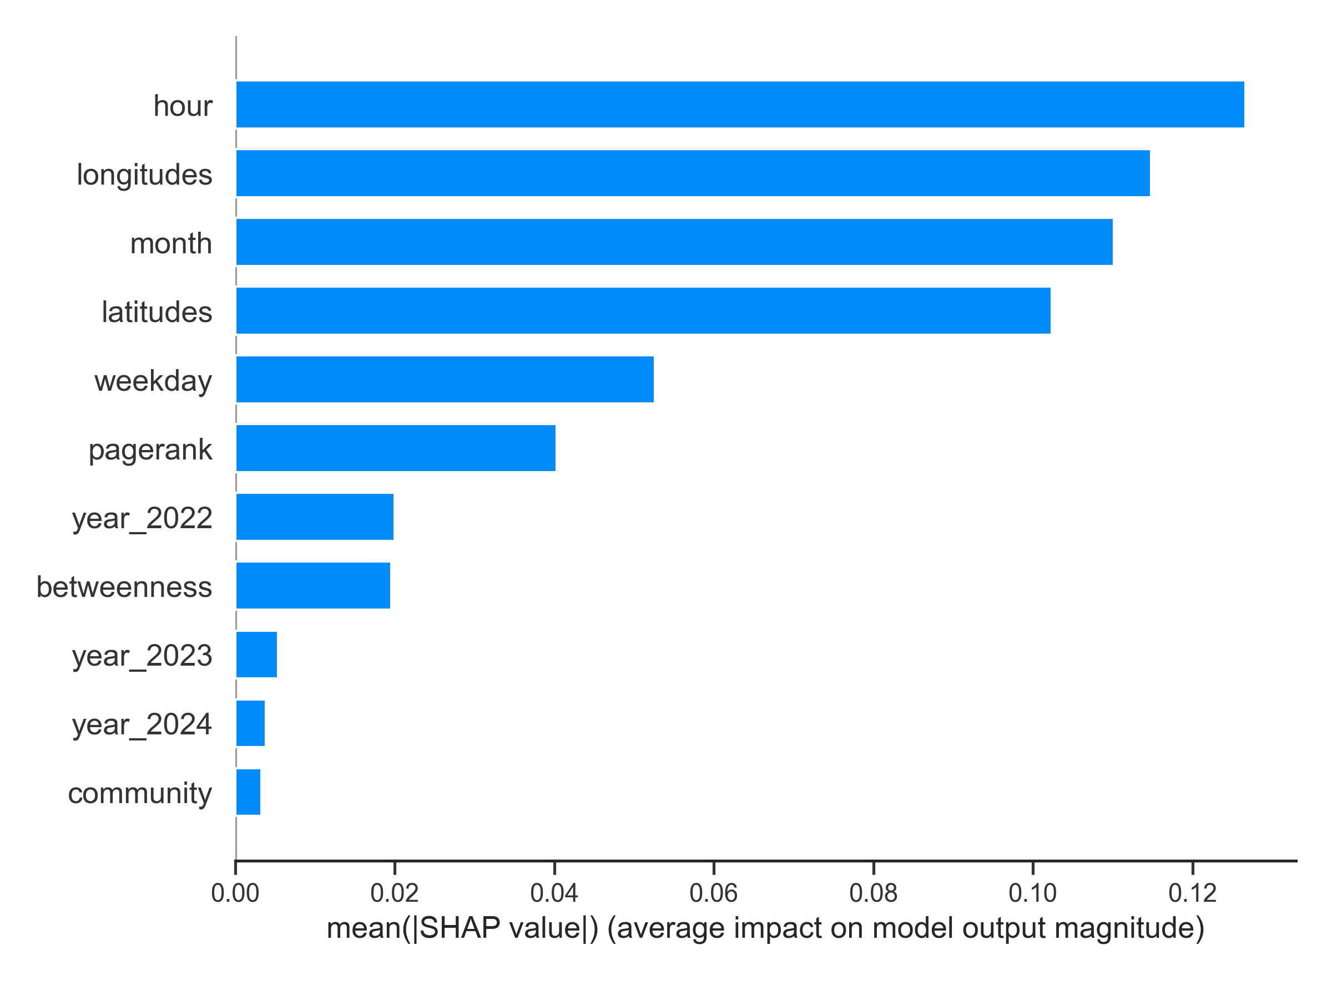
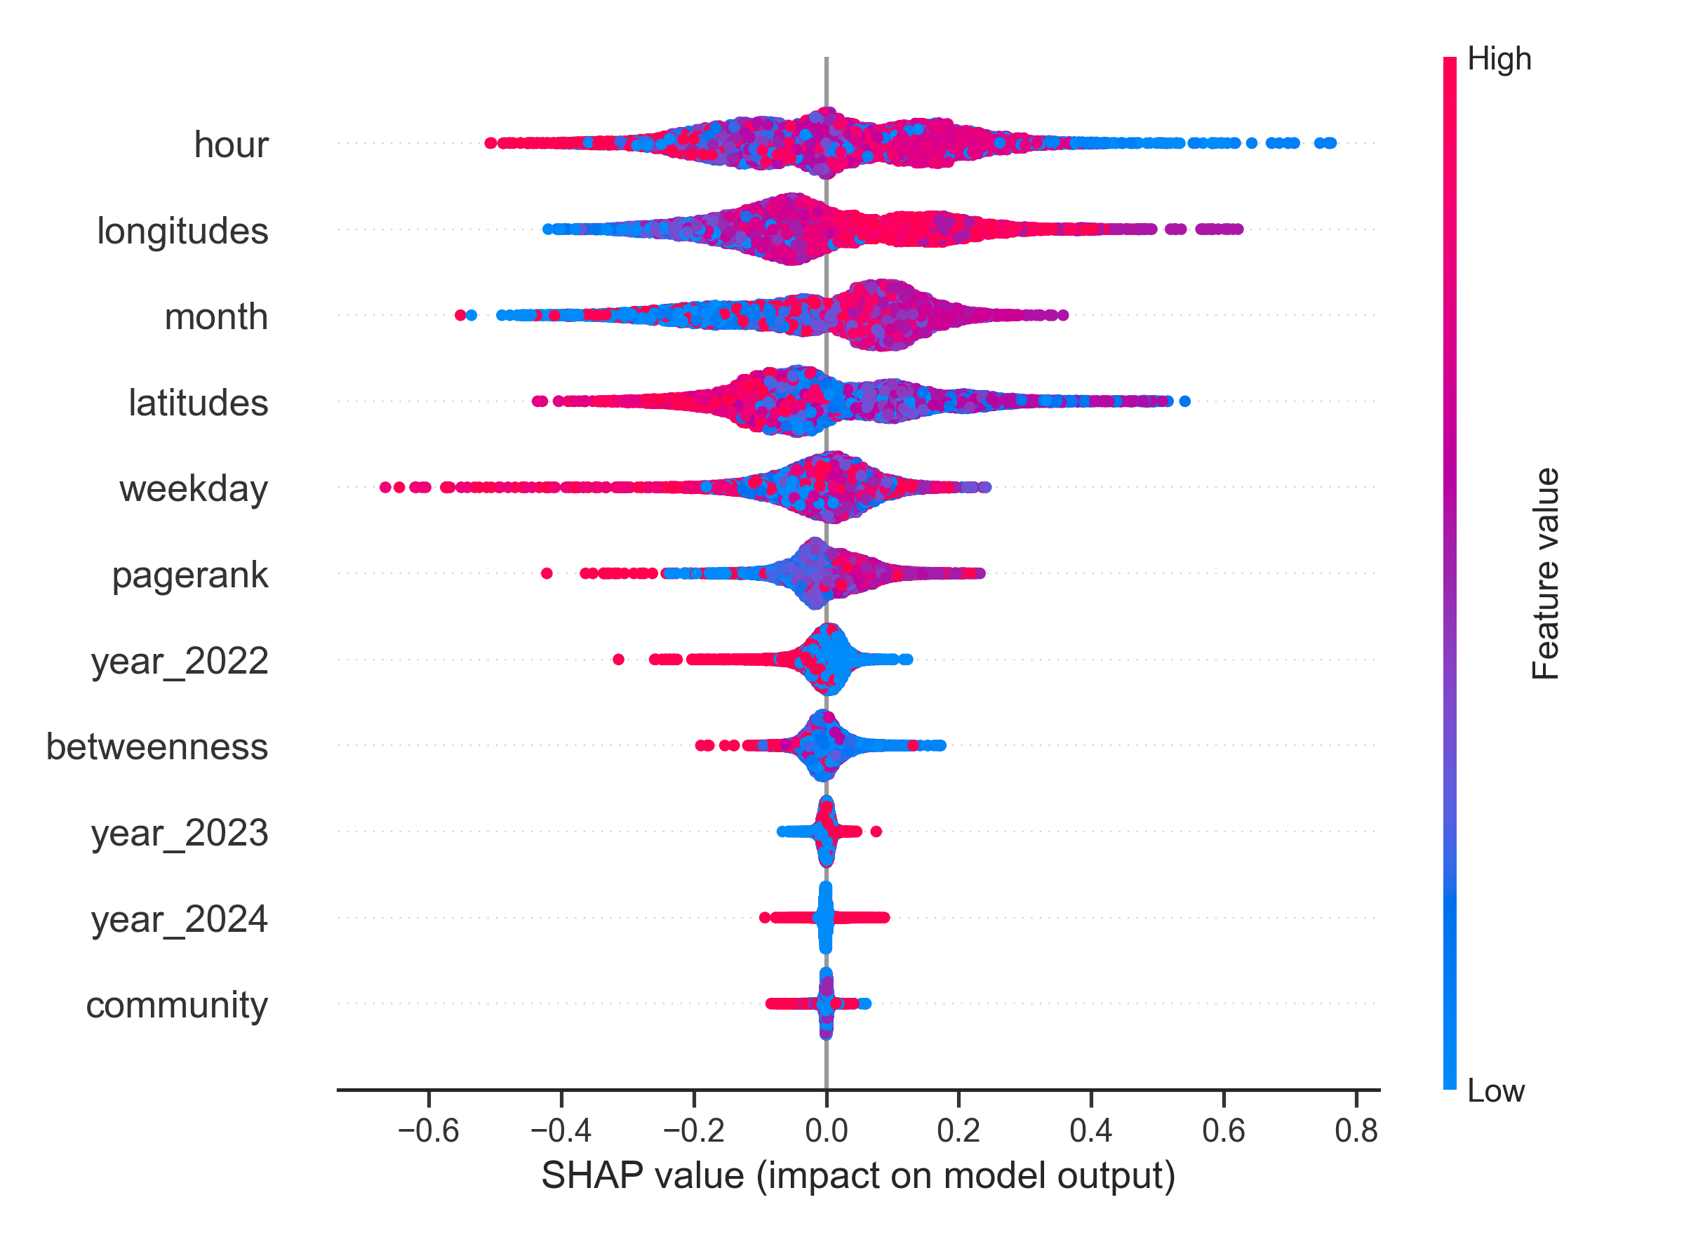
Feature Explainability
The influence of feature value on the number of incoming bike
Feature Importance

Slide 15
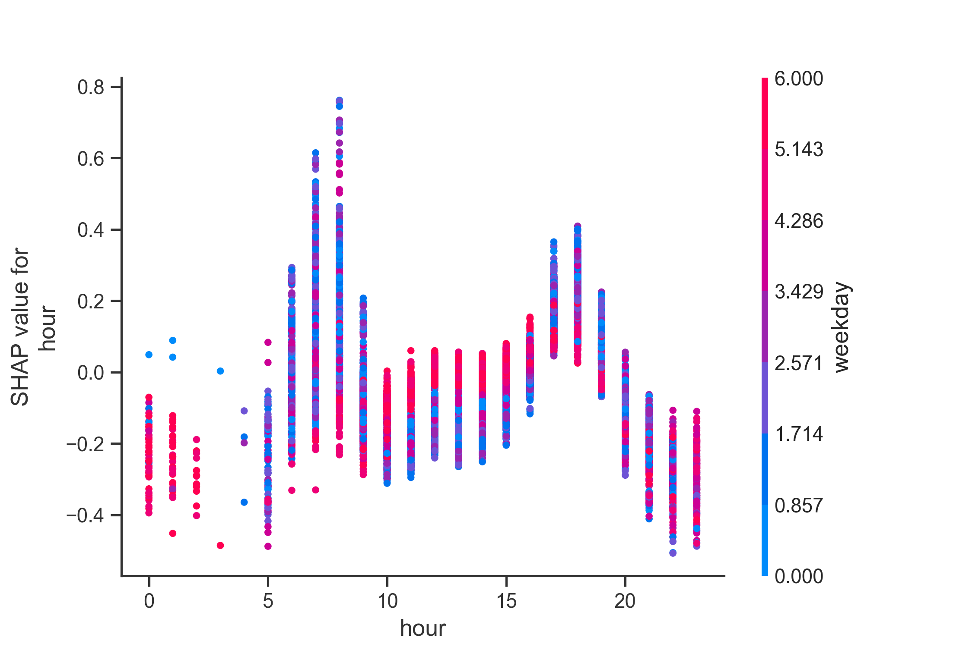
Feature Explainability
The interaction between hour and weekday is captured
Weekday peaks
Weekday peaks
Weekend Peaks

Slide 16
Conclusion
Geographical location, hour and directionality of bike ride are important for bike allocation.
Bike demand by station can be predicted and accurately forecasted.
Predicted bike allocation (2024 November 4th 8 am):
Station with most number of bikes needed: Hamilton Park 16 bikes
Station with most number of bike surplus: Grove St PATH 94 bikes

Slide 17
Bike allocation rebalancing using network flow algorithm

Slide 18
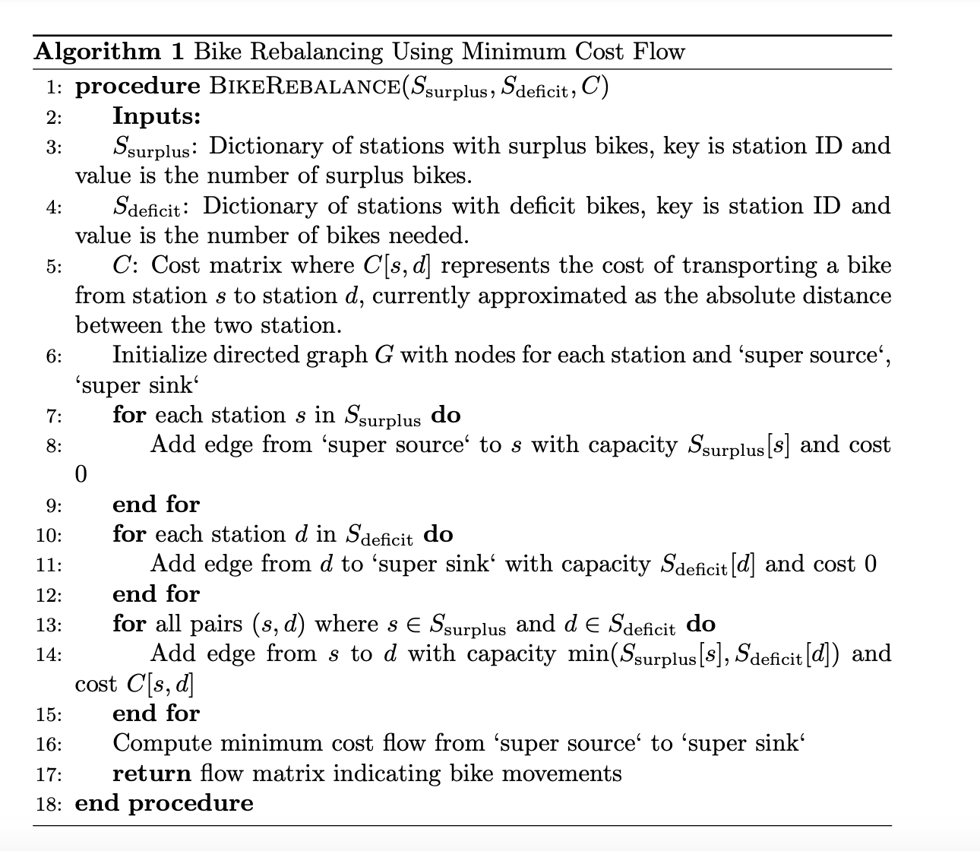
Using network flow to optimize allocation rebalancing
Surplus if incoming_bikes > outgoing bikes
Deficit if incoming_bikes < outgoing bikes
Solve using nx.min_cost_flow

Slide 19
Graph
Total bike needed per day prediction
Season, Weekday and Hour matters
MAPE:15.71
Bike needed at individual station prediction
Geospatial location, Hour and Pagerank matters
MAPE: 6.37
A Brief Summary
Feature Explainability
Bike Re-allocation
Network flow algorithm

